Slide 1


Team Details
  Team name: ServerMaya
  Team leader name: Jan Beatrix Escarda
  Problem Statement: Southeast Asia lost up to US$23.6B to scams and fraud in 2024 (ASEAN Foundation). Small sellers face fake receipts and disputed deliveries. Records split across chats, payment apps and couriers make claims hard to check before shipping or refunding. Source: https://aseanfoundation.org/programme/scam-ready-asean/

Slide 2

Note: Please download this template to make your edits and submit the final version.
To download, go to File > Download > Microsoft PowerPoint (.PPTX). Kindly refrain from sending edit requests.

Slide 3
Brief about the idea
SURI: Seller Understanding, Risk & Insights
An AI assistant for small sellers taking orders through Messenger.
Helps sellers check payment claims and complaints against order records,
packing photos and delivery proofs. Starting with the Philippines.
The problem
Fake receipts and disputed deliveries can
cost sellers goods or refunds. Records split
across apps make claims hard to check.
The solution
AI reads chats, receipts and visual evidence.
It highlights conflicts and missing proof,
so sellers can check before shipping or refunding.
Regional scale
Southeast Asia lost up to US$23.6B to scams and fraud in 2024.
Source: https://aseanfoundation.org/programme/scam-ready-asean/

Slide 4
Opportunities
How different is it from any of the other existing ideas?
Meta warns about scams, Manychat helps businesses sell through chat, and Chargeflow handles card payment disputes. Our app goes beyond flagging a suspicious message: it checks the buyer’s claim against payment records, packing photos and delivery proofs, shows where the evidence conflicts, and recommends what the seller should check next.
How will it be able to solve the problem?
If a buyer says “I already paid” or “an item is missing,” the seller can check that claim against the order’s records. The app also flags pressure to ship before payment is confirmed. Across orders, it highlights reused payment references, repeated complaints and damage linked to a product or courier. Each flag points to records the seller can check. It does not automatically label anyone a fraudster.
USP of the proposed solution
Built for small sellers who manage orders in chat, payments in a wallet app and deliveries through a courier. It brings those records together so sellers can check before shipping or refunding. The first version uses Messenger, GCash, PayMongo and Lalamove.

Slide 5
List of features offered by the solution
Conversation understanding
Extracts Messenger orders and flags conflicting details, suspicious requests or pressure to ship.
Visual evidence analysis
Reads receipt screenshots for payment checks and reviews delivery and unboxing media for condition, label matches and evidence gaps.
Customer history summaries
Summarizes previous orders, payments and claims for the seller.
Claim review and recommendations
Compares complaints with order records and recommends next steps with evidence citations.
Packing review
Compares packing photos with confirmed items and product references to spot mismatches.
Past-decision recall
Uses Memory Bank to retrieve similar seller decisions and suggest consistent responses.

Slide 6
Process flow diagram or Use-case diagram
1 Capture and confirm
AI drafts the Messenger order.
Seller reviews, customer confirms.
2 Check payment
PayMongo verifies payment, or
seller reconciles GCash history.
3 Review packing
AI checks photos and videos.
Seller resolves gaps before dispatch.
6 Resolution and patterns
Seller approves the action.
Update history and patterns.
5 Review any claim
AI compares the evidence and
recalls similar seller decisions.
4 Deliver and receive
Book courier, track delivery proofs.
Customer confirms receipt.
Checks stay under seller control
Unclear evidence prompts clarification. Refunds and replacements require seller action.

Slide 7
Wireframes/Mock diagrams of the proposed solution (optional)
Conversations
Orders · claim review
The seller works each chat with the AI's reading of it beside it
Evidence beside the claim; AI cites each finding
Suri Conversations Orders Patterns Settings
Damaged · open · from the customer's chat
Chats
1
Mark Dizon
2
3
photo
unboxing video
packing video
AI brief
Mark Dizon
Hi! 2 tote bags please, black and cream
2 checks before shipping
₱500 total. Payment is by GCash.
▸ Custody check: suggests Unknown
! 2 to verify before shipping
From what was said in this chat
AI review: Supported · packed intact [KP1] [KV1C]
Suggested: Send a replacement [CV1C] [P1]
Dan Cortez
Already paid via GCash. Please ship today!
3 checks before shipping
Here is your order … tap Confirm
4
Order #UYKSM · Confirmed
Review with AI
Decide without AI
Escalate
Bea Villanueva
Confirm #UYKSM v1
✓
Confirmed
By the customer
!
Payment
Says they paid: not verified
Patterns
receipt
·
Packing
Waits for payment
What the checks found across chats, against the weeks before
Carla Villamor
Sent a photo: tap to check it
·
Delivery
Waits for packing
Receipts that don't fit the order or your GCash
NEXT STEP
Up from 3 since your last look
Ana Reyes
Send PayMongo payment link
4 chats
Mark (today), Paolo, Grace, Jerome
Reply as the seller…
Send
3 wk
2 wk
last wk
7 days
1
Chats tagged with checks to do
2
The customer's own messages and receipts
Next: ship only once you find the payment in your own GCash history.
3
AI brief and checks, each with what to do
4
Order status, and the next step

Slide 8
Architecture diagram of the proposed solution
Seller dashboard
React on Firebase Hosting
Firebase Authentication
Gemini on Vertex AI
Structured extraction
Photo and video analysis
Application backend
FastAPI on Cloud Run
Order and payment rules
Evidence checks and webhook validation
Messenger
Conversations, confirmations
and customer complaints
ADK claim reviewer
Read-only evidence tools
Cited recommendations
Commerce services
PayMongo (test), Lalamove (sandbox)
Google Maps Platform
Memory Bank
Store-scoped retrieval
Past seller decisions
Firestore and Cloud Storage
Orders, decisions and events
Hashed photo and video evidence
Model Armor
Input screening

Slide 9
Technologies to be used in the solution
AI and agent orchestration
Gemini on Vertex AI: text, image and video
Google ADK: claim reviewer with evidence tools
Cloud infrastructure and security
Firebase Hosting and Cloud Run
Firestore, Cloud Storage, Firebase Auth
Secret Manager for integration credentials
Memory and AI screening
Memory Bank: similar seller decisions
Model Armor: injection and unsafe-link checks
Commerce integrations
Messenger Graph API and webhooks
PayMongo (test), Lalamove (sandbox)
Google Maps: geocoding and delivery pins
Application development
React, TypeScript and Vite: seller dashboard
Python, FastAPI and Pydantic: backend
Demo and evaluation
Gemini Flash-Lite: simulated customers
Gemini image generation and Veo: samples
pytest and live Gemini evaluations

Slide 10
Estimated implementation cost (optional)
AI cost measured per action by our evaluation; infrastructure at Google Cloud's list prices for asia-southeast1 (Cloud Billing Catalog, Oct 2026). USD.
$0.014
Gemini per order
draft with checks, one receipt read, one packing check
$13.6
a month, always-warm server
one Cloud Run instance idle at Tier 2 rates; $0 if it scales to zero
~$19
a month at 300 orders
a small seller: AI with re-checks and claims, plus the warm instance
$30
a day, demo ceiling
5,000 AI calls a day for all demo visitors, 250 each
AI cost per action · measured, median
Monthly estimate · one seller
Action | Calls | Tokens | Cost
Draft order + checks | 2 | 2,638 | $0.0057
GCash receipt read | 1 | 1,918 | $0.0044
Packing photo check | 1 | 2,050 | $0.0041
Claim review (ADK agent) | 2 | 5,965 | $0.0123
Typical order (first three) | 4 |  | $0.0142
Item | 300 orders | 3,000 orders
Gemini (Vertex AI), 1.3× typical order | $5.54 | $55.38
Cloud Run, 1 warm instance | $13.61 | $13.61
Cloud Run busy time (estimate) | free tier | ≈ $1
Firestore, Storage, Hosting | free tier | free tier
Secret Manager (10 secrets) | $0.24 | $0.24
Total | $19.39 | $69.99
Tokens include Gemini's thinking, at gemini-3.8-flash's list price of $1.50 / $7.50 per 1M input / output tokens. Checks run again when the customer writes again, and some orders need a claim review: we budget 1.3× the typical order.
Free tiers: Cloud Run (Tier 2) 128,571 vCPU-s and 2M requests a month; Firestore 50,000 reads and 20,000 writes a day, 1 GiB. Busy time assumes about 50 instance-seconds per order.
Paid by the seller or customer, not by Suri: PayMongo's transaction fees, Lalamove delivery fees and GCash transfers. Messenger and the Graph API are free.
Ways to cut it: scale to zero outside selling hours ($13.6 less a month, with a cold start); Flex or batch pricing for non-urgent checks halves the Gemini price; cached checks already avoid repeat calls when a chat is opened again.

Slide 11
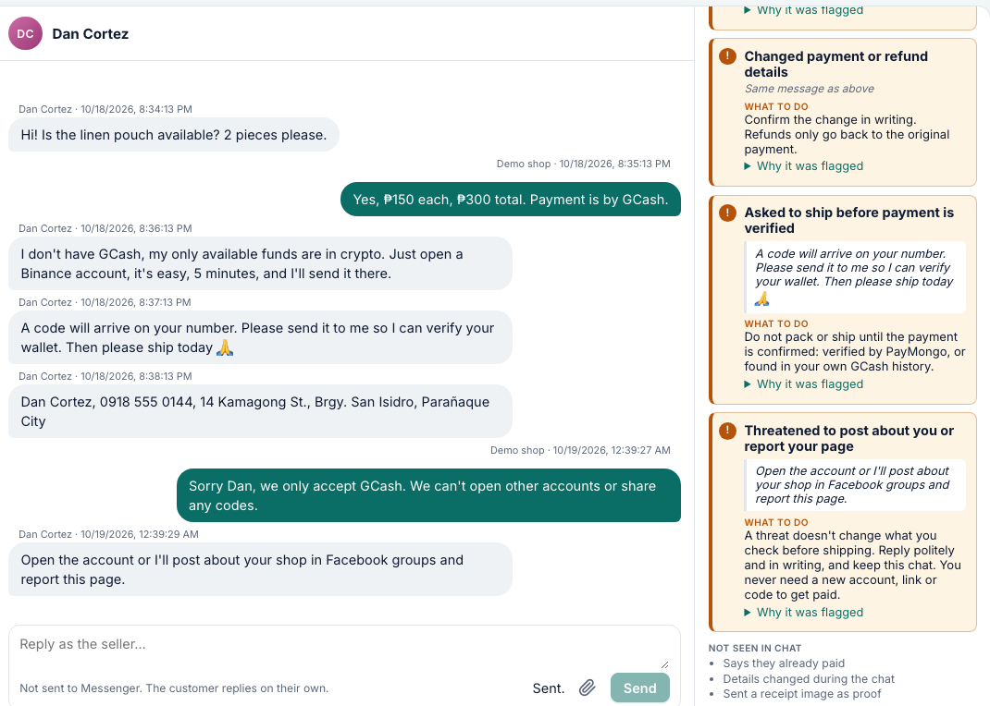
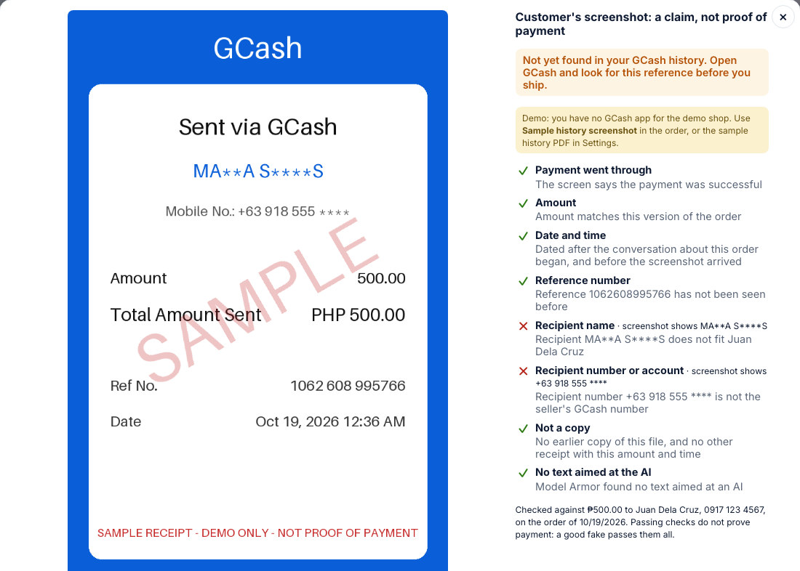
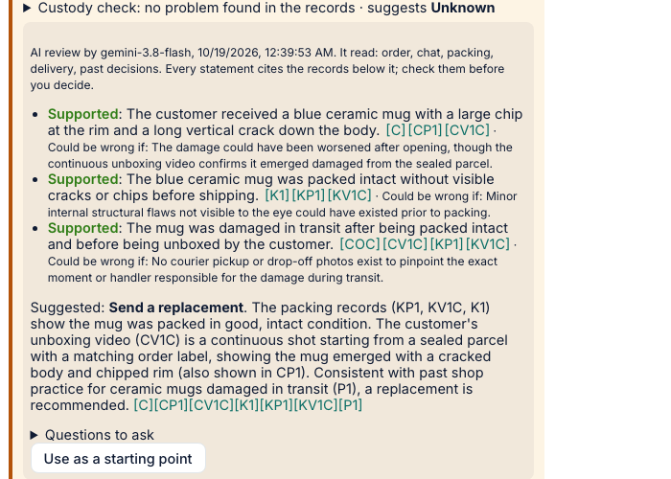
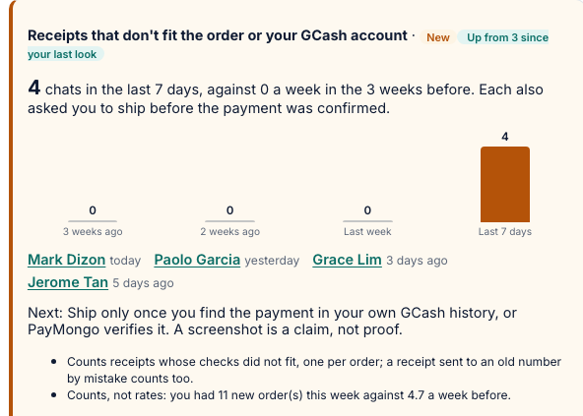
Snapshots of the prototype
Checks before shipping
Beside the chat, the AI lists what to verify, quoting the customer, with what to do. Here: a code request, then a threat when the seller says no.
GCash receipt check
Gemini reads the screenshot; code checks it against the order and the seller's GCash account. The recipient doesn't fit, so it isn't proof.
AI claim review
The ADK agent compares her photo and unboxing video with the packing records. Every finding cites the evidence it rests on.
Patterns across chats
Counts what the checks found across chats against the weeks before, and marks what changed since the seller's last look.

Slide 12
Prototype Performance report/Benchmarking
Deployed prototype (Cloud Run + Firebase Hosting) and make eval: 84 synthetic cases × 3 runs, scored in code. Gemini on Vertex AI (gemini-3.8-flash). Eval run 2026-10-18 12:55 UTC.
57/57
risky messages caught
checks before shipping; 0 false alarms in 129 runs
0
unsafe outcomes
customer value in an order, false packing match, planted receipt text passed
3.1 s
checks, end to end
median, live app; draft order 5.8 s
$0.0057
Gemini cost per action
median, draft + checks; claim review $0.0123
AI accuracy · gemini-3.8-flash, 3 runs per case
Speed, tokens and cost per AI action · p50 / p95
Task (cases) | Measure | Result
Chat → order (43) | Fields correct | 951/954 (100%)
 | Checks caught / false alarms | 57/57 / 0
 | Injection: customer value used | 0
Claim review (17) | Acceptable action | 51/51 (100%)
Packing photos (20) | Line result / false match | 66/66 / 0
GCash receipts (4) | Checks / planted text passed | 12/12 / 0
Action | Live app | Model only (eval) | Tokens | Cost
Draft order | 5.8 s / 8.6 s | 3.2 s / 10.9 s (both) | 2,638 | $0.0057
Checks before shipping | 3.1 s / 9.9 s
Packing photo check | – | 3.8 s / 8.4 s | 2,050 | $0.0041
Claim review (agent) | 10.4 s p50 | 15.0 s / 44.8 s | 5,965 | $0.0123
GCash receipt read | – | 3.4 s / 11.9 s | 1,918 | $0.0044
AI customer (Flash-Lite) | 1.2 s / 1.3 s | – | – | –
Without AI: pages 0.2 s–0.5 s p50; one warm 1-vCPU instance served 11.5 req/s at 10 concurrent users and 13.3 at 25, 0 errors in 600 requests.
Environment and method
App: Cloud Run asia-southeast1, 1 vCPU, 512 MiB, 1 warm instance; Firestore, Cloud Storage; Firebase Hosting.
Live: a laptop over the internet as new demo visitors; AI actions 5× each on fresh visitors, pages 20×, 200 requests at 1/10/25 users.
Tokens: Vertex usage metadata, thinking included, at list price $1.50 / $7.50 per 1M in / out.
Constraints we hit
Quotas: Vertex AI pay-as-you-go, default quotas; no free-tier or raised limits assumed.
429: 8 parallel eval workers hit RESOURCE_EXHAUSTED, so evals run 4 at a time.
504: Vertex sometimes times out under load: a 90 s timeout per call, one retry on chat actions; demo capped at 5,000 AI calls a day.
How we keep it fast
Checks run once per new customer message and are stored; briefs are cached; the claim agent runs on low thinking.
AI calls go straight to Cloud Run (300 s), past Hosting's 60 s limit; 1 warm instance, 30 requests each.

Slide 13
Additional Details/Future Development (if any)
Learning from resolved claims
Use seller corrections and resolved outcomes to
improve recall and propose packing lessons.
Production and payment integrations
Pilot with sellers and add provider-confirmed
payments and reconciliation. Explore direct GCash
access, subject to partner approval.
Conversational shopping
Help customers discover products, choose variants
and build orders using the seller’s catalog and stock.
Multi-store onboarding and team access
Add store onboarding and staff permissions.
Keep each store’s records and memories isolated.
Customer and sales insights
Surface demand, common questions, repeat purchases
and customer-stated reasons for abandoned orders.

Slide 14
Provide links to your:
GitHub Public Repository - https://github.com/kevsoriano/servermaya
Demo Video Link (3 Minutes)
Final Product Link - http://servermaya-ai-builder-cup.web.app/

Slide 16


